Slide 1
Hiring Coordinator Reference Guide
How to Create a PARF in PageUp

Slide 2
To begin, log into PageUp by visiting: https://msstate.pageuppeople.com

Slide 3
Complete the DUO login using your netID and password to enter PageUp.

Slide 4
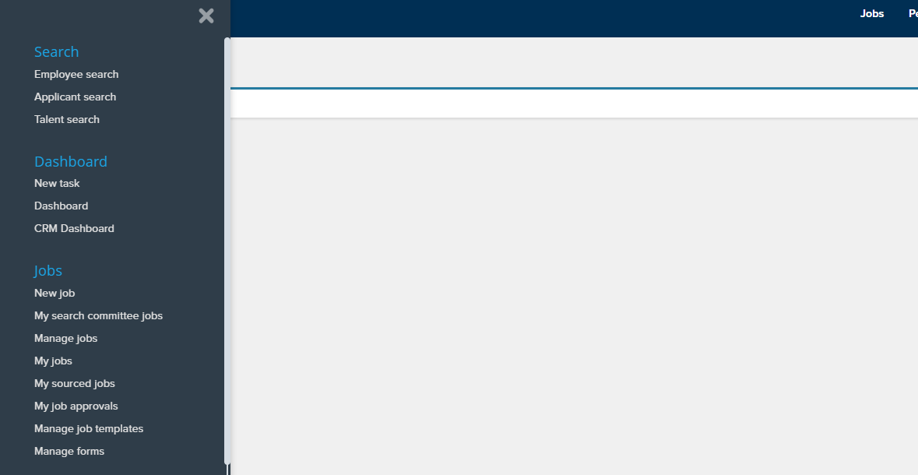
Once you have logged into PageUp, select the hamburger icon in the upper left hand corner of the page as seen below.** Then select new job to begin.
** you may not see all these options.

Slide 5
This is your start page to create your PARF.
Position is where you enter the position number for the PARF you are creating. If you do not know the position number, leave blank or search for it using the binocular icon to the right of the text box. The eraser next to it is used to remove any position number entered into the box

Slide 6
Next select an appropriate template.
Template is where you select the PARF template to use for your posting. Most of the available options are for support staff. If it is not a support staff position, you can select the appropriate option (faculty, intermittent, etc.…)
Preview shows the template selected.
Select next to continue.

Slide 7
New Job Page- PARF information
Posting title will auto populate unless a completely new position.
{
Area of Specialization is utilized to designate specific expertise such as Biological Engineering, Chemistry, or others. Typically used for Faculty positions.
PARF number leave blank. The system will generate this for you.

Slide 8
New Job Page- Headcount Management
Position no. will auto populate based off your selection on the beginning page.
Type is a drop-down menu. Select from new or replacement. Use replacement if you are refilling an existing position, otherwise select new.
{
The new and replacement boxes on the bottom right are used if you are needing multiple positions. If you are only posting for one new hire/replacement leave empty.

Slide 9
New Job Page- Position Details
If this is a new position, select yes. This step requires approval from your HRM generalist before moving forward. Also, if any changes to the position were made contact your HRM generalist prior to posting. For faculty or existing positions with no changes, select no.
Current/Previous incumbent name: if you are replacing an exiting employee enter their name here. Otherwise, leave this blank.
{
Resignation Date: if you are replacing an exiting employee enter their resignation date/last day here. Otherwise, leave this blank.

Slide 10
New Job Page- Position Details
Division: Auto populates but if it fails to do so, select from the drop-down menu.
Department: Auto populates but if it fails to do so, select from the drop-down menu.
{
Recruitment Process: Here you select the position type utilizing the drop-down menu. For this example we selected support staff.
Department Profile: Entered by the department providing a brief description of the hiring department or unit.

Slide 11
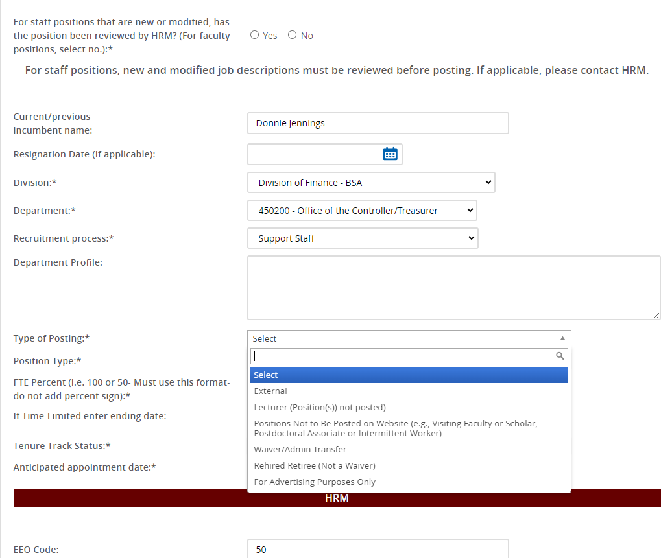
New Job Page- Position Details
Type of Posting: Utilize the drop-down menu to select the type of posting, for example external or internal.
Tenure Track Status: Utilize the drop-down menu to select whether the position is tenured, tenure-track, non-tenure track, or N/A.
Position Type: Utilize the drop-down menu to select the type of position, for example Regular Full-Time 12-month or rehired retiree.
Anticipated Appt. Date: Date you anticipate this position being filled.
FTE Percentage: Amount of time devoted to the position. If full-time enter 100.
If Time-Limited: If this position ends following a grant or is temporary, enter the date here.
{

Slide 12
New Job Page- HRM
The HRM section is completed by the HRM generalist. Leave blank. If information does populate here, leave it as is.

Slide 13
New Job Page- Funding Information
Joint appointment refers to if the position will be funded from two departments/units. Select yes if it is, no if only one source of funding is used.
Restricted Clause typically refers to grant funded positions that are contingent on funding availability. Select the appropriate choice depending on funding source.
Is the position budgeted? If so select yes from the drop down menu.
{
Account Information and Comments refer to the Banner Account number for the funding source and any details you want to include about the funding. Typically comments are made if the position is not budgeted.
Amount budgeted is the salary you have budgeted for the position. If it is not budgeted, leave blank.
Fiscal year for the budgeted amount.

Slide 14
New Job Page- Funding Information
Salary requested for the waiver is entered here if applying for a waiver, otherwise leave blank.
Apply for a waiver is used when doing an administrative transfer to a new position, promotion, or if you have someone in your department you want to move into a new position without interviewing
Existing pool PARF is where you enter the previous PARF you are pulling the candidate for the waiver, otherwise leave blank.
Reason for waiver is a drop-down menu to select the main reason for applying for a waiver.
Justification is a written explanation (with details) about why you want this waiver for this position.
Name of new hire is entered here if applying for a waiver, otherwise leave blank.

Slide 15
New Job Page- Position Description
Title/Title Code is auto populated by the system. However, you can still search if needed using the magnifying glass icon.
Essential Duties describes what the position will be responsible for accomplishing.
Minimum Qualifications is where you enter the required minimum qualifications to apply. For example, a master’s degree and 5 years experience.
Salary Grade is left blank for HRM to fill in.
UC. If this position is unclassified, enter the salary range information here. For Faculty enter the salary, for intermittent or rehire/retiree use the hourly rate.
ABDs is a drop-down menu where you select if the committee will accept All But Dissertation for positions requiring a PhD.
Position Function is a brief overview of job functions. This will auto populate if a template was chosen at the beginning. Includes teaching and percentages of time and is department dependent.
Preferred Qualifications is where you enter the qualifications you would like the applicant to have for the position. These are typically higher than the minimum qualifications but not required to apply.

Slide 16
New Job Page- Position Description
KSA is the list of knowledge, skills and abilities you are looking for in a candidate. For example, experience with Adobe Photoshop or grant writing experience.
Working Conditions lists the typical working situations. For example, normal office environment, travel expectations, etc.
Instructions for Applying refers to what materials you want an applicant to provide/complete. For example, complete the online application, include a resume/CV, cover letter, transcripts, or number of references.
Select yes or no for resume and cover letter required. Usually select yes, unless it is a support staff position or intermittent.
Selection Criteria is left unused.

Slide 17
New Job Page- Search Committee
Apply for a search committee is selected when you know you have or want search committee to review applicants/interview candidates. If you do not know that you want a committee, or who will serve leave this no. Your HRM generalist can add it after the posting if needed.
Add Search Committee member is where you add additional committee members if you know them already. Otherwise leave blank. This can be added later, as well, by your HR generalist.
Add additional viewers is used to add people that can view the applicants but are not necessarily on the committee.
Search committee chair is where you enter the person responsible for the hiring. Typically the supervisor or the committee chair. If you do not know the person yet, leave blank. Use the magnifying glass to search for a specific name if needed.

Slide 18
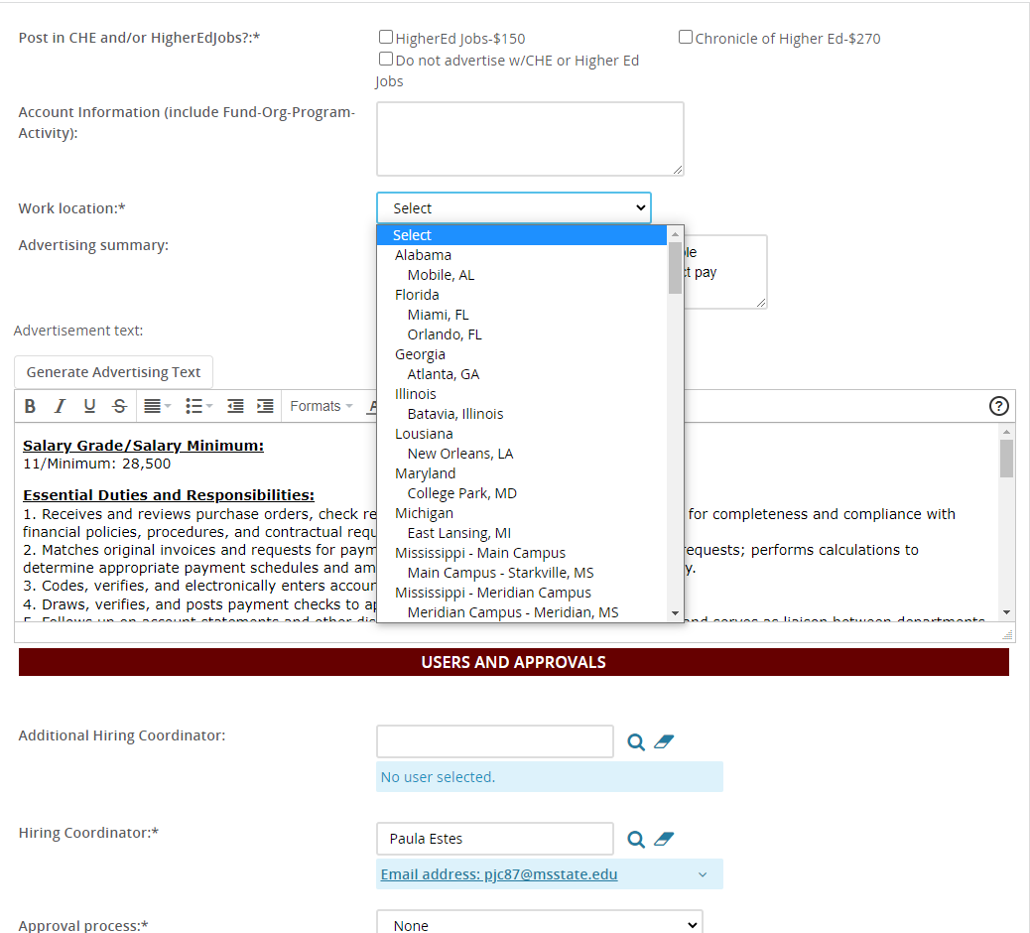
New Job Page- Advertising Details
Post in CHE and/or HigherEdJobs is selected when you want to post on these external job sites. Please note there is a fee for these services. If you only want the posting shown on the MSU jobs site, select do not advertise.
Account information is where you enter the Banner fund information if you are paying for the outside services.
Work location is a drop-down menu where you select the location of the job. For example, MSU main campus in Starkville, Meridian, or another off-campus location.

Slide 19
New Job Page- Users and Approvals
Additional Hiring Coordinator is filled out when you want to have multiple people have access to the PARF. Enter the name or use the magnifying glass to search.
The HR Generalist responsible for your division is entered here. If you are unsure who that is, visit hrm.msstate.edu to find your generalist.
Next page takes you to the notes page. You do not need to select this unless you have supporting documents to upload or notes to add.
Hiring Coordinator is where you enter your information as the person creating the PARF.
Approval Process is a drop-down menu where you select the appropriate approval process for the PARF you are creating. For example, if you need your department head and VP to approve the posting before HR releases it, select the 2 step approval process. This is determined by the department. If you have questions, ask your supervisor or HR Generalist.
If you are finished with the PARF, select submit and exit.
If you will be returning to complete the PARF select save a draft. You will be able to return to complete it without losing information.

Slide 20
You have now submitted your PARF.
If you have questions, you can contact your HR Generalist or
Paula Estes, Employment Services Coordinator.
Paula Estes pestes@hrm.msstate.edu

